Slide 1
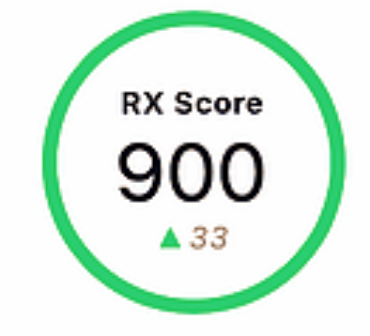
Common Services
Mean Score
Common CVE’s
Office 365
CV1 3333333
Skype
CV2 3333333
Hootsuite
CV3 3333333
CV4 3333333

Slide 2
Graph features
Zoom
Pan
Select / Multiselect
Be able to collapse or expand each node’s sub nodes by clicking on it
Show logo of company when zoomed in and legend when zoomed out.
Display common CVE’s when a selection of companies have been selected.
Display common services when a selection of companies have been selected.
Display a mean score when a selection of companies have been selected.

